Slide 1

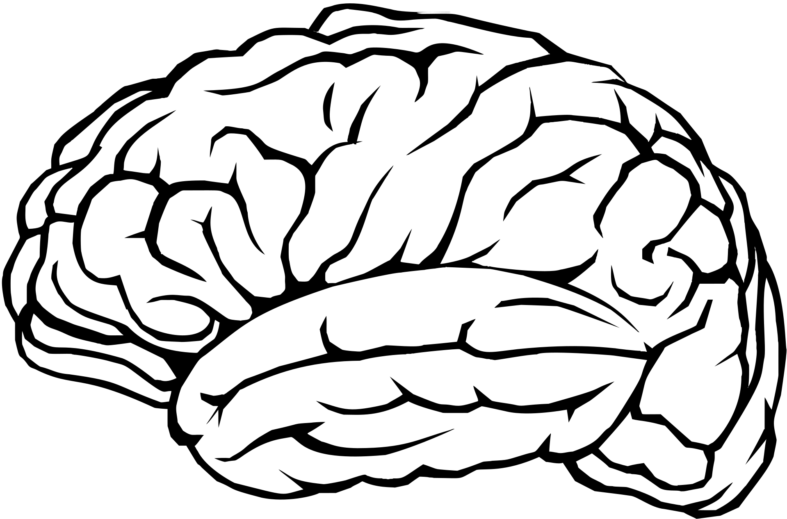



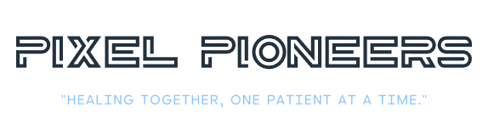
National Hackathon-Computer Vision-2k23
Use Case 4: Detection and Classification of Tumors in Medical Images (X-Rays and MRIs)
Team: Pixel Pioneers
Team ID: 5833
Notes:
Good afternoon to all present today.
We are team rotonity and we are here to present our project - SCOBO, the medical bot.

Slide 2
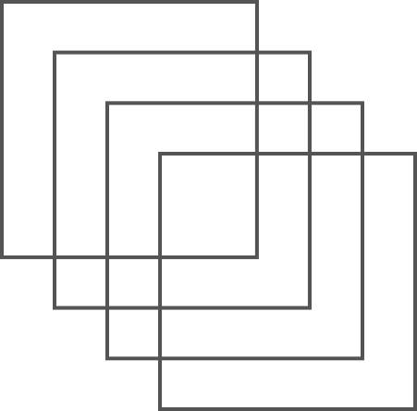




Our Team
Aditya Rane
Prachi Lal
Vinay Patil
Notes:
This is our team

Slide 3

Introduction
Brain tumors are a highly aggressive disease.
In 2021, over 84,000 people received a primary brain tumor diagnosis, and around 18,600 died from malignant brain tumors (brain cancer).
The most effective technique for detecting brain tumors is Magnetic Resonance Imaging (MRI).
Faster diagnosis and optimal treatment plans are essential to improve the life expectancy and well-being of patients.
It is a vital step in diagnosing and treating a multitude of medical conditions. This use case takes us deep into the realm of innovation, where computer vision technology comes to the forefront, aiding medical professionals in making informed decisions and, ultimately, elevating patient outcomes.
Notes:
The healthcare industry is facing a huge challenge due to high patient numbers with staff shortage.
This has caused experts to raise concern over compromised patient safety.
The added burden on healthcare workers increases the risk of human errors in administering medication and cross contamination
Innovations in tech and healthcare have become ever more important to up the overall quality of patient care.

Slide 4
Problem Statement
Accurate and timely detection and classification of tumors in medical images (X-rays and MRIs) is crucial for healthcare.
Current methods rely on manual interpretation, leading to potential delays and errors in diagnosis.
The challenge is to develop an automated system using computer vision technology to:
Detect potential tumor regions in medical images.
Classify tumors into specific categories (e.g., benign or malignant).
Generate real-time alerts for medical professionals.
This system aims to enhance the efficiency and accuracy of tumor diagnosis, ultimately improving patient care and outcomes in medical imaging.
Notes:
The healthcare industry is facing a huge challenge due to high patient numbers with staff shortage.
This has caused experts to raise concern over compromised patient safety.
The added burden on healthcare workers increases the risk of human errors in administering medication and cross contamination
Innovations in tech and healthcare have become ever more important to up the overall quality of patient care.

Slide 5
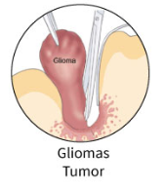
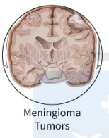
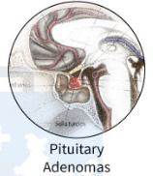
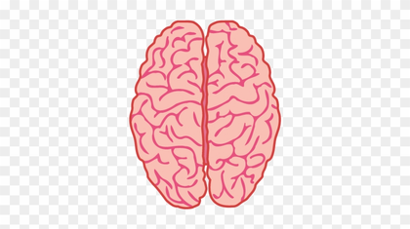
Objectives
To identify if the MRI image of the patient has Brain Tumor or not.
If Yes, classify the brain tumor into three types, as follows:
Glioma Tumor
Meningioma Tumor
Pituitary Tumor
No tumour
Treatment Planning
To maintain patient records for further analysis.
Notes:
The healthcare industry is facing a huge challenge due to high patient numbers with staff shortage.
This has caused experts to raise concern over compromised patient safety.
The added burden on healthcare workers increases the risk of human errors in administering medication and cross contamination
Innovations in tech and healthcare have become ever more important to up the overall quality of patient care.

Slide 6
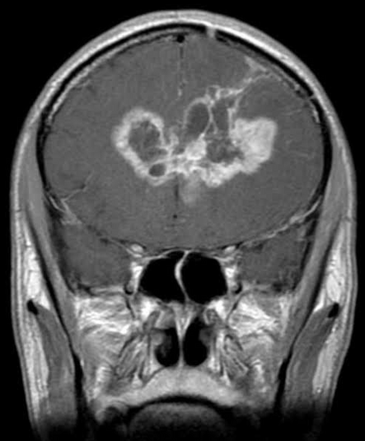
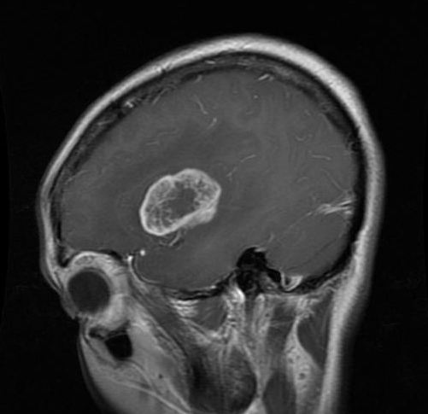
Dataset
The dataset contains a collection of Magnetic Resonance Imaging (MRI) scans of the brain.
These scans have been used for the purpose of classifying brain tumors.
The dataset is divided into 4 main categories, indicating the presence or absence of a brain tumor.
Each category contains subcategories for specific types of tumors, such as glioma tumor, meningioma tumor, pituitary tumor and no tumor.
Notes:
The healthcare industry is facing a huge challenge due to high patient numbers with staff shortage.
This has caused experts to raise concern over compromised patient safety.
The added burden on healthcare workers increases the risk of human errors in administering medication and cross contamination
Innovations in tech and healthcare have become ever more important to up the overall quality of patient care.

Slide 7

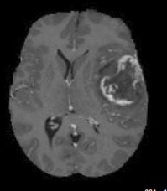

CNN Network
H3K27M-0
H3K27M-1
DATA
ACQUISITION
FLAIR
INPUT
LAYER
CONVOLUTION
LAYER
POOLING
LAYER
FULLY
CONNECTED
LAYER
OUTPUT
LAYER
CNN BLOCK
Notes:
The healthcare industry is facing a huge challenge due to high patient numbers with staff shortage.
This has caused experts to raise concern over compromised patient safety.
The added burden on healthcare workers increases the risk of human errors in administering medication and cross contamination
Innovations in tech and healthcare have become ever more important to up the overall quality of patient care.

Slide 8
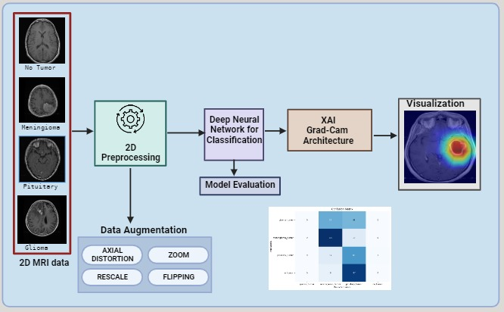
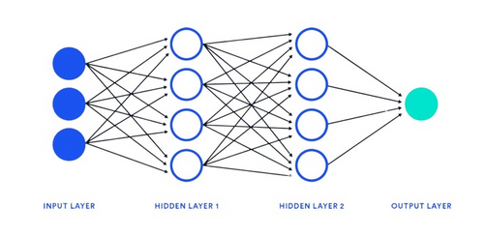
CNN Architecture
Notes:
The healthcare industry is facing a huge challenge due to high patient numbers with staff shortage.
This has caused experts to raise concern over compromised patient safety.
The added burden on healthcare workers increases the risk of human errors in administering medication and cross contamination
Innovations in tech and healthcare have become ever more important to up the overall quality of patient care.

Slide 9
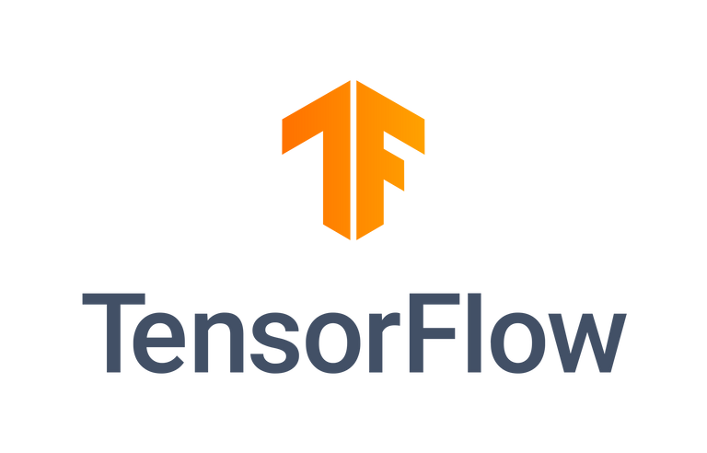

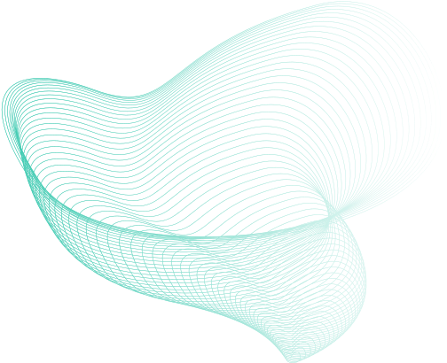
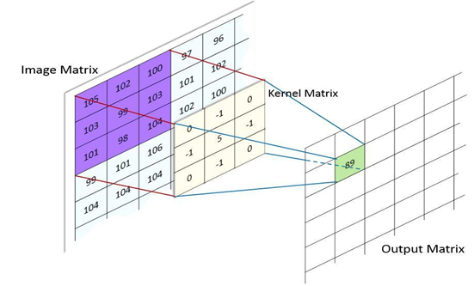

Deployment and Use Cases:
Algorithm Approach
CNN Model Design And Its Parameters:
Server
Web Services
Flask, Python, HTML, CSS
Clients
Doctors
For validation of tumor class.
To monitor Tumor growth or shrinkage.
Patients
To keep account of multiple MRI.
For personal use and validation without doctor’s assistance.
Structure
Similar to ANN with addition of Convolution and Pooling .
Convolution
It is a kernel filter for feature extraction.
Provides a pooled feature map.
Pooling
Its a function to reduce the amount of parameters in network.
Pre Processing Stage
Gray Scaling
Reduce the images to gray spectrum.
Helps reduce complexity of images.
Resizing
Resizing the images to lower resolution.
Helps reduce all images to an uniform dimension.
Augmentation
Generating multiple images from a single image.
Helps create more data set for training.
Edge Detection
Using edge detection algorithms like Canny, Prewitt.
Helps highlight tumor part in image.
Notes:
ROS & SLAM Algorithms -
Robot Operating System is a set of software tools and libraries made for robotics.
SLAM algorithms come as a part of ROS.
SLAM stands for Simultaneous Localization and Mapping. SLAM Algorithms allow for a robot to know its current position in space and can map out a path best suitable for it in its environment with static and dynamic mapping data.
LIDAR stands for Light Detection and Ranging.
It is a time of flight sensor with millimeter precision with a range in several meters.
OpenCV is an open source library for computer vision and it can be used for patient recognition
UV-C radiation is used for disinfecting spaces and can partially or totally reduce microbial load on surfaces and can be implemented to disinfect hospital environments.
Thermal imaging converts IR into visible images indicating temperature differences. It can be used to detect a patient's temperature.

Slide 10
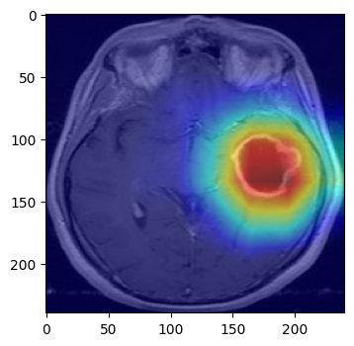
Grad CAM
GradCAM (Gradient-weighted Class Activation Mapping) is a visualization technique used in deep learning to understand where neural networks focus when making predictions.
In medical imaging, such as MRI scans for brain tumors, GradCAM can pinpoint regions of interest within an image that contribute to a model's diagnosis.
GradCAM enhances model transparency by providing heatmaps that highlight crucial image regions, aiding radiologists and clinicians in their assessments.
GradCAM can improve diagnostic accuracy by revealing the areas within an MRI scan that the model considers indicative of potential tumors.
GradCAM is becoming a valuable tool in medical diagnostics, facilitating faster and more accurate brain tumor detection. Ongoing research seeks to further refine and integrate this technology into clinical practice.

Slide 11
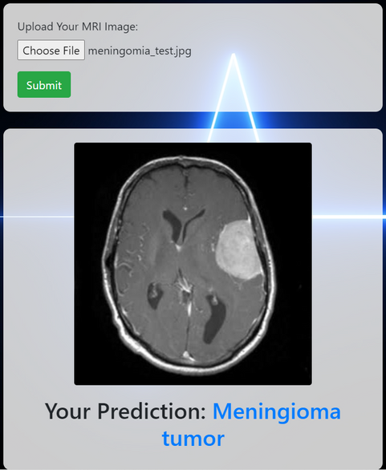
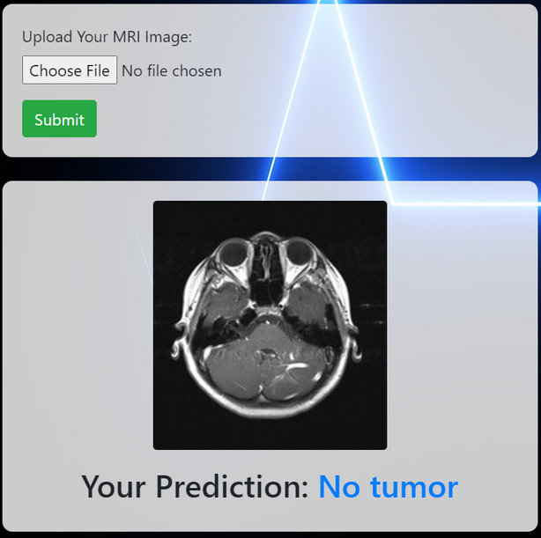
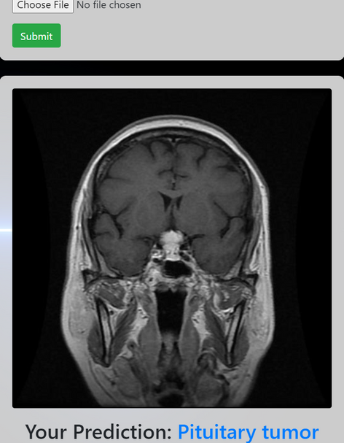
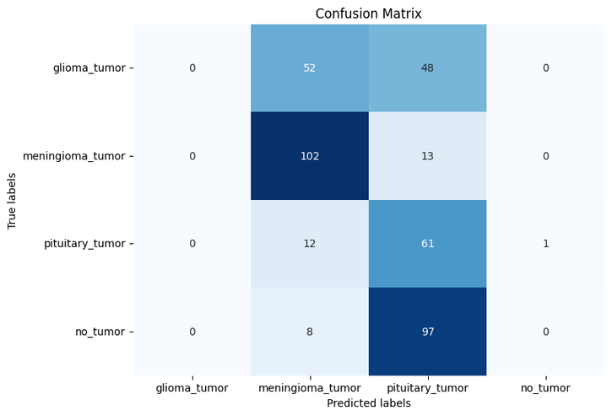
Results Achieved
Notes:
To alleviate the mentioned problems, we have SCOBO - the medical bot.
scobo is a fully autonomous robot that will revolutionize healthcare robotics.
It uses technologies like LIDAR Ranging, ROS, SLAM Algorithms to achieve autonomy, navigating complex hospital environments seamlessly.
The robot is equipped with the some of the best technologies to assist in tasks like administering medication, monitoring health parameters like BP, SPO2 (blood oxygen), medical supply delivery, UV-C disinfection, and video calling to the doctor's desk.

Slide 12
PIXEL PIONEERS
PIXEL PIONEERS
PIXEL PIONEERS
PIXEL PIONEERS
PIXEL PIONEERS
PIXEL PIONEERS
IMPLEMENTATION

Slide 13
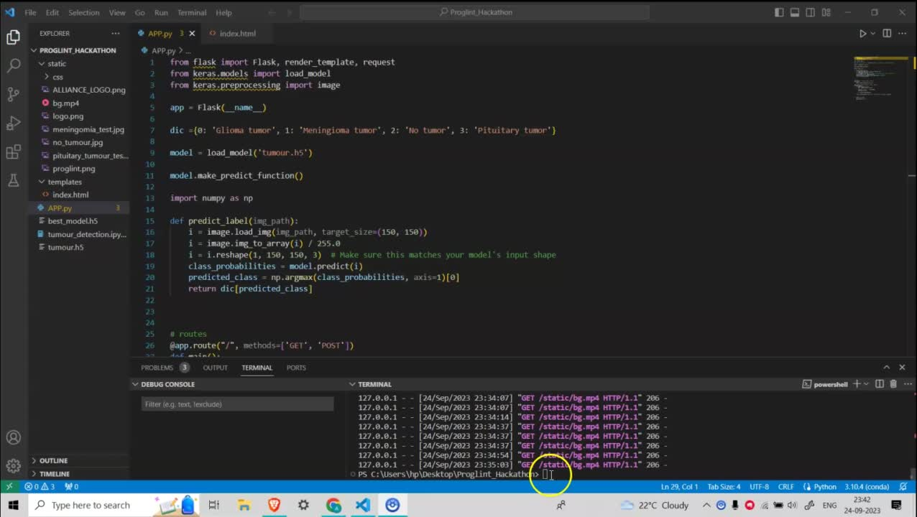
PIXEL PIONEERS
PIXEL PIONEERS
PIXEL PIONEERS
PIXEL PIONEERS
PIXEL PIONEERS
PIXEL PIONEERS
Notes:
Buck converter is a step-down transformer to cut down the high voltage of the battery (24v) to 12V and 5V for powering the various components.
The arduino acts a lower level controller, receiving commands from a higher level controller, acting as an intermediary between it and the motor driver.
The Nvidia Jetson is the higher level controller running ROS. The jetson is at the heart of everything and makes all signal processing possible with its high processing power coupled with its smaller footprint.

Slide 14

Thank you!
INSTITUTE
Symbiosis Institute of Technology, Pune
Symbiosis International University
EMAIL
aditya.rane.btech2020@sitpune.edu.in
vinay.patil.btech2019@sitpune.edu.in
prachi.lal.btech2020@sitpune.edu.in
Notes:
THANK YOU!

